Slide 1
Teaching Video
Functions and Class
Gaurav Roy
MSEN-CS
Email: garo7740@colorado.edu
Live Green

Slide 2
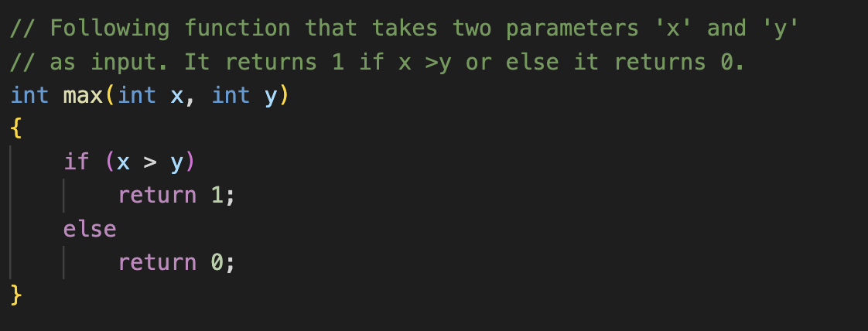
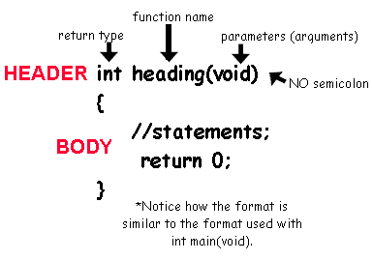
Functions
What is a function ?
A function is a block of organized, reusable code that is used to perform a single, related action or a specific task.

Slide 3
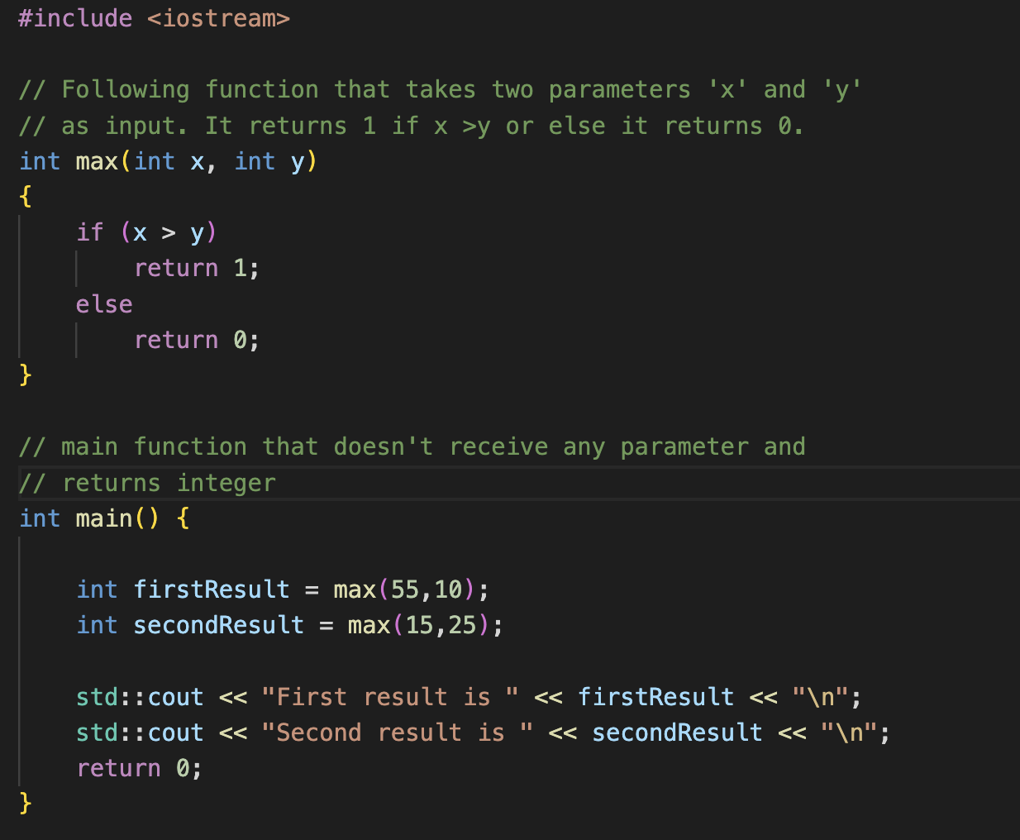
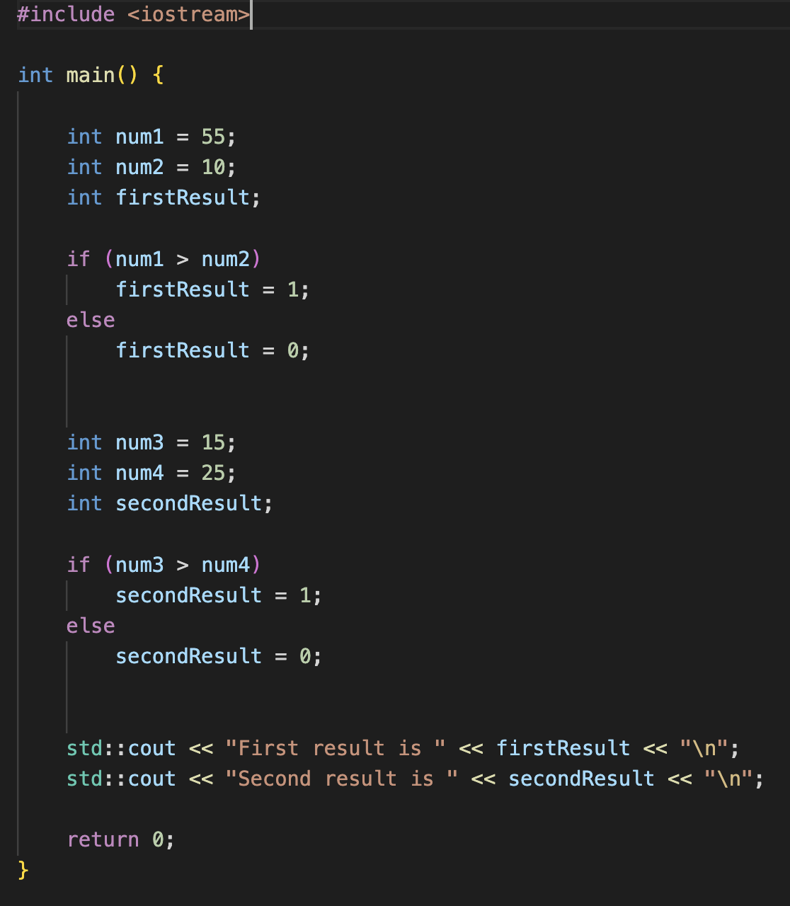
Functions
Why do we need Functions and how to test them ?
With Function
Without Function

Slide 4
Class
Objects
What is a Class ?
Class
iPhone
A class is a user-defined data type that we can use in our program, and it consists of data members and member functions.
Mobile
Moto T
It acts as a "blueprint" or template for creating objects.
Samsung Galaxy
An object is an instance of a class. When a class is defined, no memory is allocated but an object is created, memory is allocated.
Attributes(color, size)
Methods(phone calls, camera)

Slide 5
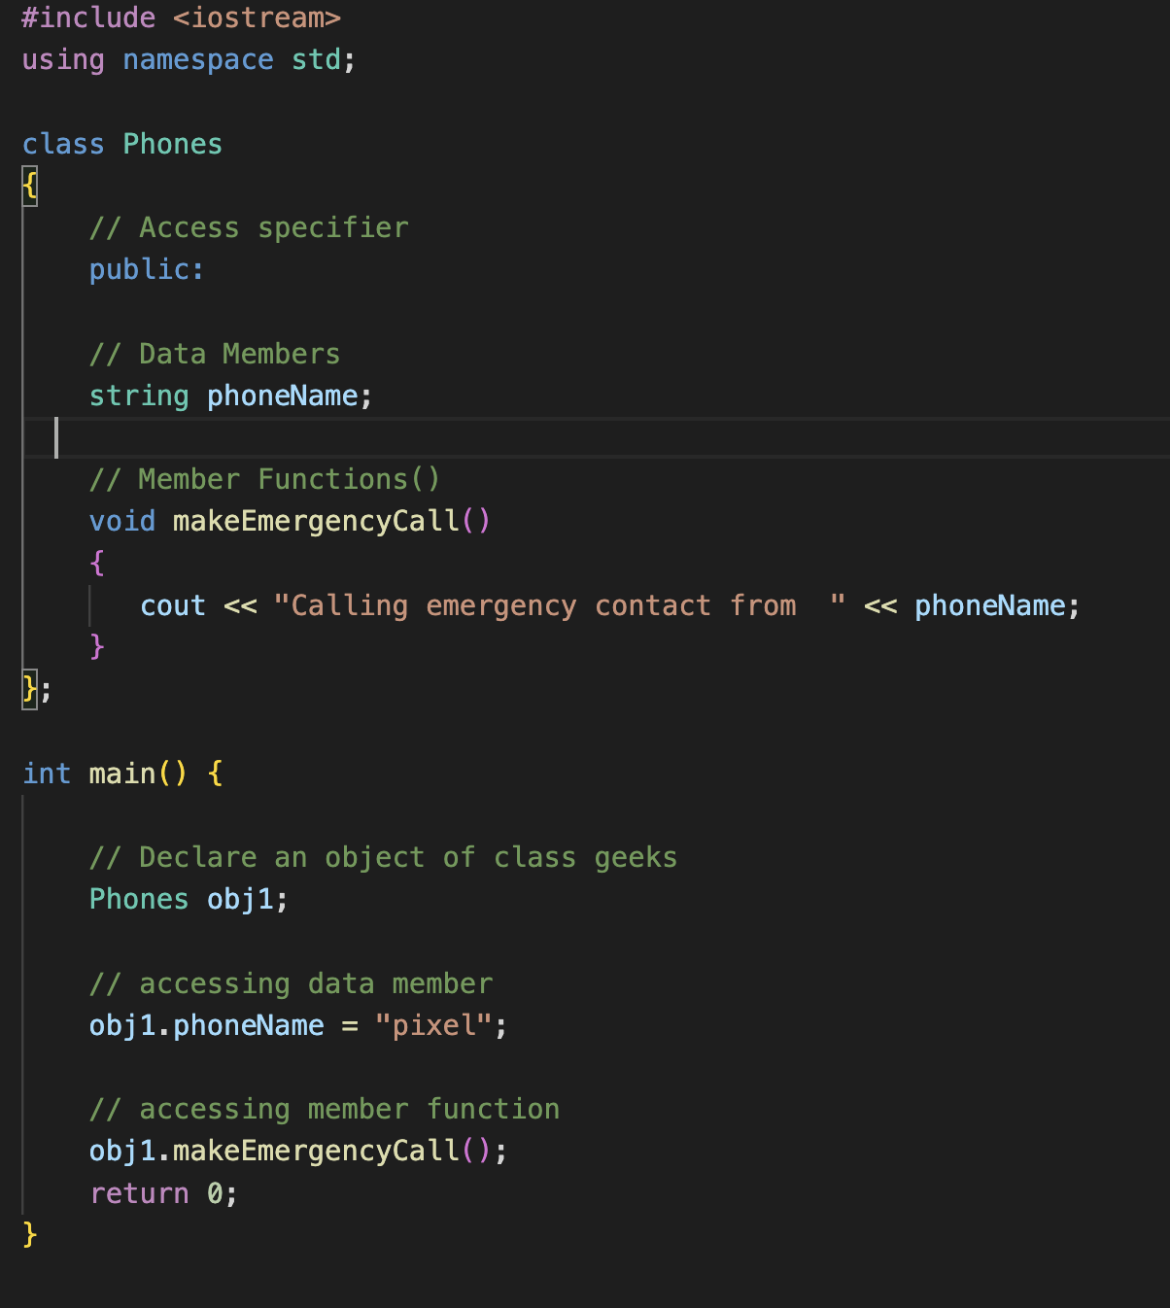
Class
How does a class look like and how do we test it?
To test the member functions of a class, we’ll need to create a object of that particular class.
We’ll have access to the data members and member functions of a class by using a dot operator.

Slide 6
Thank you!
Feel free to reach out to me in case of any questions.

